Slide 1

EvilTwinX: Understanding Rogue AP Attacks
EvilTwinX, a tool designed for educational purposes to simulate and analyze rogue access point (Evil Twin) attacks combined with captive portal phishing. Our goal is to empower cybersecurity researchers, red-teamers, and network defenders with insights into attack mechanics, detection strategies, and mitigation techniques to harden Wi-Fi networks.

Slide 2
Chapter 1
Executive Summary & Scope
EvilTwinX is a lab-only, educational tool illustrating how rogue APs and captive portals harvest WPA/WPA2 passphrases. It verifies these against captured handshakes, providing a safe environment for authorized testing. This report covers its design, components, test environment, observations, limitations, and defensive recommendations.
Primary Objectives
Out of Scope
Reproducible PoC for Evil Twin + captive portal credential harvest.
Unauthorized targeting of live networks.
Offensive features beyond educational PoC needs.
WPA/WPA2 handshake capture and passphrase verification.
Integration with third-party cracking services.
Automated logging and cleanup for safe, repeatable lab testing.

Slide 3



High-Level Methodology: The Three-Pronged Approach
EvilTwinX operates by observing, impersonating, and verifying, simulating a common attack chain to help defenders understand and counter such threats.
1. Observe
2. Impersonate
3. Verify & Close
Put wireless radio in monitor mode, scan for APs and clients, and capture WPA/WPA2 handshake packets during client reconnections.
Create a fake AP with the legitimate SSID, provide DHCP/DNS, and serve a captive portal requesting the Wi-Fi password.
Validate submitted passwords against captured handshakes. If correct, store securely, then terminate services and restore the environment.
This outline is for defensive research and education only, not for malicious use.

Slide 4
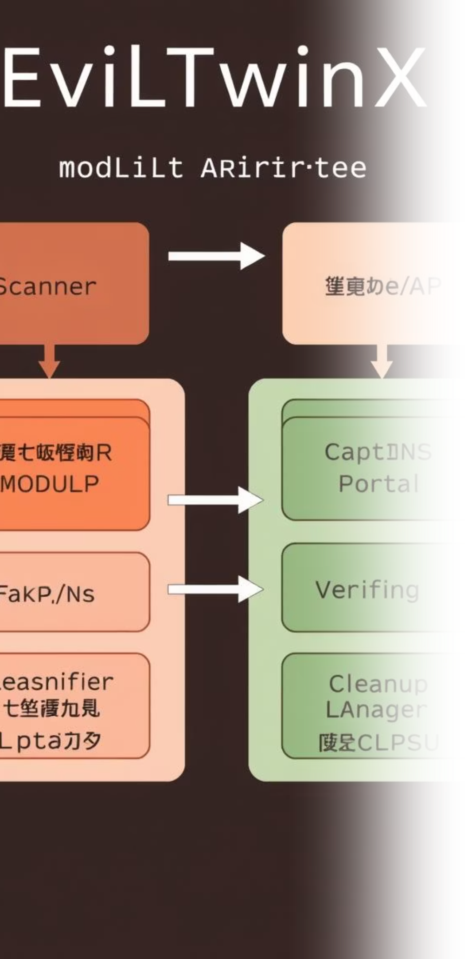
Chapter 2
Architecture & Components
EvilTwinX is built with modular components, each handling a specific function within the attack simulation process.
Scanner / Handshake Capture: Observes target APs/clients and records handshake packets.
Captive Portal (PHP): Serves login page, logs password submissions for verification.
Verifier: Compares submitted passwords to captured handshakes.
Deauthentication Module: Triggers client reconnections for handshake capture.
Logging & Storage: Records requests, attempts, and verified passphrases.
Fake AP (Evil Twin): Broadcasts target SSID to attract clients.
Cleanup Manager: Reverts processes, iptables rules, and radio modes post-test.
DHCP/DNS Service: Assigns IPs and resolves fake hostnames for the portal.

Slide 5



Controlled Test Environment
All EvilTwinX experiments are conducted in a strictly controlled lab environment using dedicated hardware to ensure safety and prevent impact on external networks.
Lab Setup
Host: Debian-based Linux (Kali) with root access.​
Radios: Two USB Wi-Fi adapters (one for monitor/injection, one for AP mode).​
Tools: Standard open-source network utilities and a custom PHP captive portal. ​
Isolation: RF-controlled room or low transmit power to avoid interference.
Strictly for lab use: EvilTwinX is for authorised testing only. Deployment against third-party network is illegal and unethical.

Slide 6
Chapter 3
Operational Flow & Observations
The operational flow demonstrates the step-by-step process of an Evil Twin attack, from setup to cleanup, highlighting key observations from lab tests.
01
02
Initialize & Scan
Capture Handshake
Prepare directories, reset files, set wlan0 to monitor mode, then scan for and select target AP.
Run passive capture, trigger deauths to boost reconnects. Observation: Deauths increase success, but require active client reconnections.
03
04
Launch Evil Twin & Phish
Verify & Cleanup
Configure AP radio, start DHCP/DNS/Captive Portal. Log submitted passwords. Observation: Redirecting HTTP traffic requires careful iptables/dnsmasq config.
Validate password against handshake. If verified, save and cleanup. Observation: Verification is reliable with valid handshakes; cleanup reduces artifacts but requires explicit process termination.

Slide 7
Limitations & Responsible Use
Understanding the limitations of EvilTwinX is crucial for accurate analysis and responsible deployment in lab environments.
Technical Limitations
Ethical & Legal Constraints
HTTPS & Captive Portal Detection: Modern devices often bypass simple HTTP redirection, potentially showing warnings or bypassing the portal entirely.
Authorized Testing Only: EvilTwinX is strictly for lab use on networks you own or have explicit, written permission for.
Handshake Dependency: Verification requires a complete and valid handshake capture for the specific SSID/client.
Scope & Consent: Always define clear scope, timing, and acceptance criteria with network owners before any engagement.
Dual-Band Complexity: Simultaneous 2.4 GHz and 5 GHz attacks demand multiple capable adapters and intricate channel planning.
Data Handling: Securely delete all captured credentials post-testing; never publish, share, or reuse real credentials.

Slide 8



Chapter 4
Defensive Recommendations
Mitigating Evil Twin attacks requires a multi-layered approach spanning user education, robust network configurations, and advanced detection mechanisms.
User & Policy
Network Config
Detection & Logging
Educate users on Wi-Fi authenticity verification.
Prioritize WPA3 for enhanced security.
Monitor for deauth spikes and association events.
Enforce connection to trusted SSIDs via device management.
Implement 802.1X (Enterprise) with EAP.
Correlate unusual DHCP/DNS activity for portal hostnames.
Enable Management Frame Protection (802.11w).
Deploy Rogue AP detection (WIDS/WIPS).

Slide 9

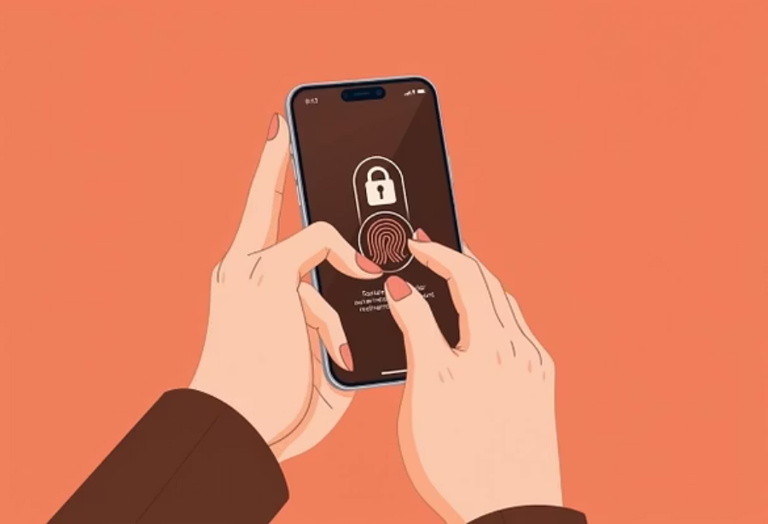
Key Recommendations for Defenders & Researchers
To effectively counter sophisticated Wi-Fi attacks, defenders must focus on robust authentication, continuous monitoring, and multi-factor security.
Deploy Enterprise Wi-Fi (WPA2/WPA3-Enterprise): Utilize server authentication (certificates) to significantly reduce captive-portal credential theft risks.
Monitor Management Frames: Establish thresholds and alerts for high volumes of deauthentication packets to detect potential attacks.
Multi-Factor Authentication (MFA): Implement MFA for all critical services to prevent account takeover even if Wi-Fi PSKs are compromised.
Wireless NAC & Continuous Monitoring: Employ wireless network access control solutions and integrate continuous monitoring for anomalous behavior.

Slide 10

Future Work & Closing Remarks
EvilTwinX serves as a powerful educational tool. Our future enhancements aim to further improve its utility for defensive research and training.
Enhancements
Conclusion
Multi-adapter orchestration for dual-band attack simulation.
EvilTwinX demonstrates real-world Wi-Fi phishing concepts in a controlled lab. Its true value lies in improving detection, hardening networks, and educating users — not facilitating unauthorized access. Use this tool responsibly and only with explicit permission.
Automated lab mode for reliable client/portal simulation.
Configurable portal templates for defensive testing realism.
Telemetry and reporting features (logs, timelines, metrics).
Installer with dependency checks and capability warnings.

Slide 11
THANK YOU..

